Slide 1
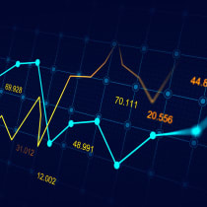
S&P 500 forecasting & Portfolio Construction
Jinghan Chen

Slide 2
Summary
Introduction
Methodology & Data
Analysis & Result
Conclusion & Next Steps

Slide 3
Introduction - Background & Motivation
Effective forecasting models are important to make informed decisions
Standard & Poor 500 (S&P 500) is a well-diversified Market Cap Weighted Index
Potential influential factors:
Macroeconomic conditions
Technical indicators
Portfolio construction strategy
Modern Portfolio Theory (MPT)

Slide 4
Methodology & Data

Slide 5
Methodology
Monthly index data
Key macroeconomic indicators
Three technical indicators from each of the general category
Exploratory Data Analysis
Lagged Return & Cross-Correlation
Modeling & model selection
Autoregressive integrated moving average (ARIMA)
Seasonal Auto-Regressive Integrated Moving Average with eXogenous (SARIMAX)
Recurrent Neural Network (RNN) & Long Short-Term Memory (LSTM)
Portfolio Construction using MPT

Slide 6
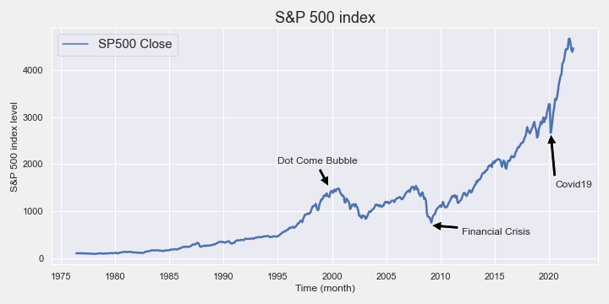
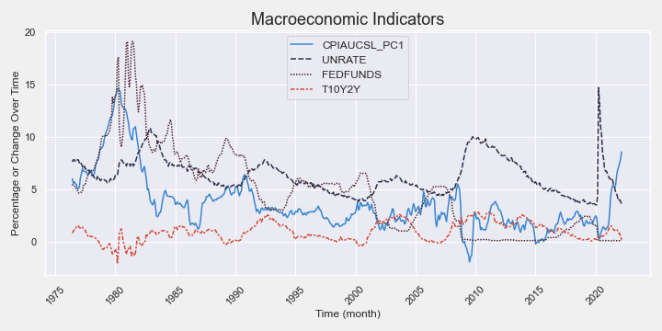
Data – S&P 500 Index & Macroeconomic Indicators
Yahoo finance API (yfinance)
^GSPC
Volume, High, Low, Close
Federal Reserve Economic Data (FRED)

Slide 7
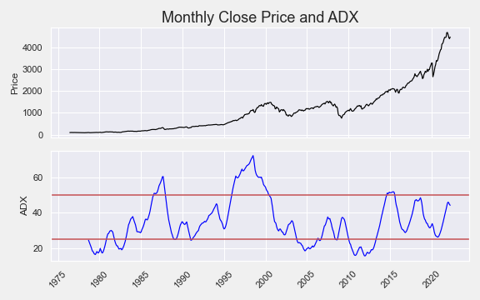
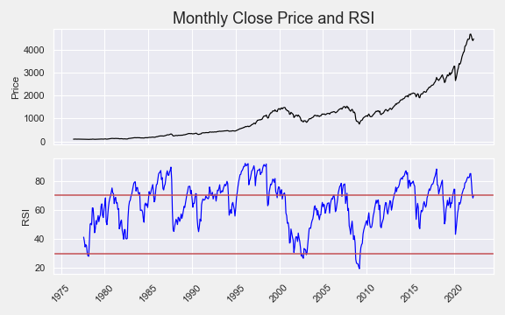
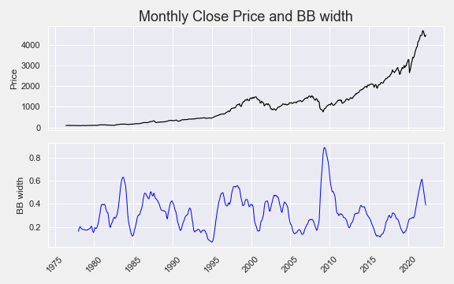
Data – Technical Indicators
Technical Indicators (Talib)
Average Directional Movement Index (ADX)
Strength of a trend. The higher the magnitude of ADX, the stronger the trend
Relative Strength Index (RSI)
Momentum of a trend by determining if a stock/ index is overbought or oversold
Bollinger Band width
Implied volatility of the stock/ index movement

Slide 8
Analysis – Univariate Lagged Return

Slide 9
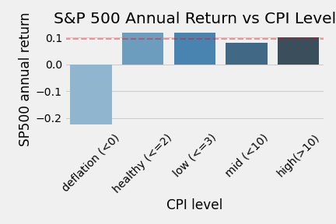
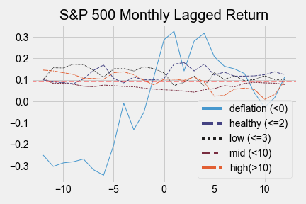
Consumer Price Index - Inflation
Deflationary environment
Worst performance, most volatile
Healthy & low inflationary environment
Tend to outperform
High inflationary environment
Tend to outperform before dipping below the average after 5 months

Slide 10
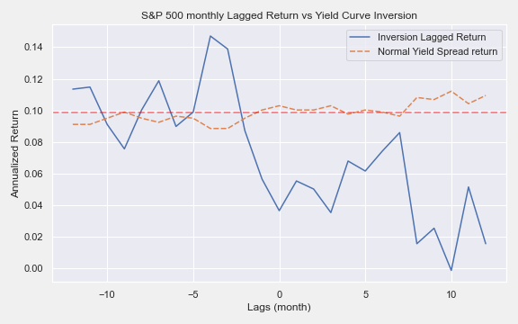
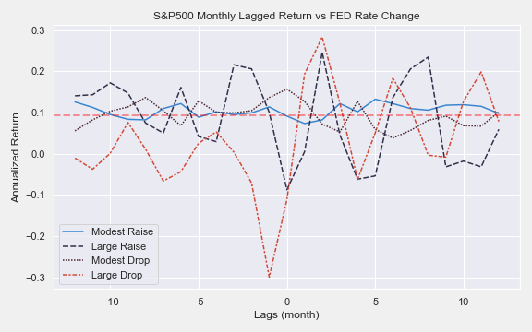
Impact of the Federal Reserve (FED)
Normal yield spread is around the market return
Outperform around 4 months going into the yield curve inversion as investors anticipate FED policies outlook to significantly impact yield curve
Rally after the yield curve inverted
React differently based on the FED rate changes
Outperform under a modest raise follow by a small dip after the rate hike
Extremely volatile under large drop

Slide 11
Analysis – FED vs Inflation

Slide 12
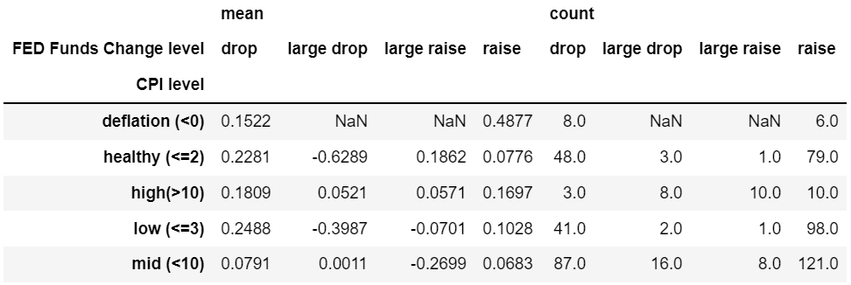
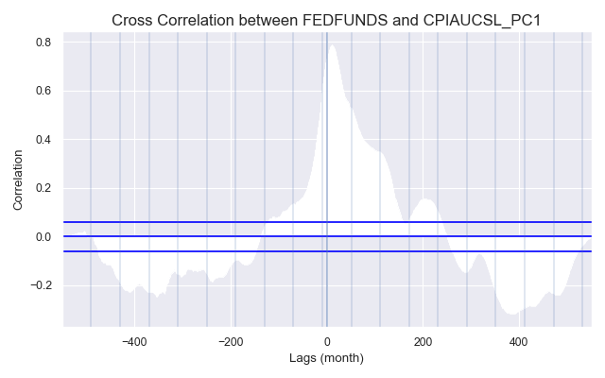
FED vs Inflation
Tend to raise the FED funds rate when the CPI is raising
Tend to have negative returns when the FED has large policy changes
More policy changes in the mid-level inflation environment
Tends to raise the FED funds rate in an inflationary environment to tighten the economy and drop the FED funds rates to stimulate the economy

Slide 13
Analysis – Technical Indicators

Slide 14
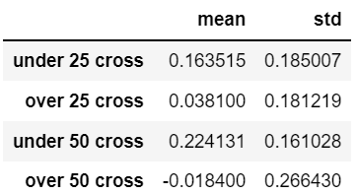
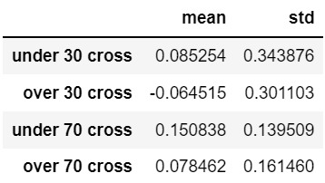
Technical Indicators
ADX
ADX key levels: 25 & 50
Sideways movement, continue in the direction of the breakout
Cross over vs cross under
RSI key levels: 30 & 70
Overbought vs oversold
Cross over 70 > cross over 30
Trade when RSI crosses over 70 as it has the highest expected return and lowest volatility and realize profit/ cut loss when RSI crosses under key levels
RSI

Slide 15
Analysis – Modeling & Portfolio Construction

Slide 16
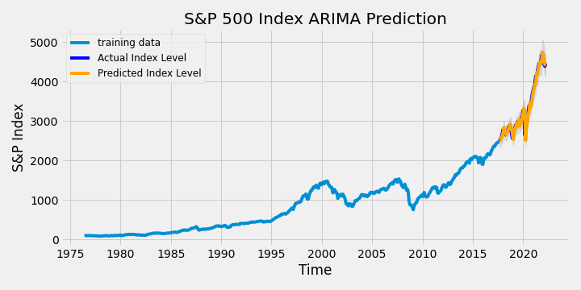
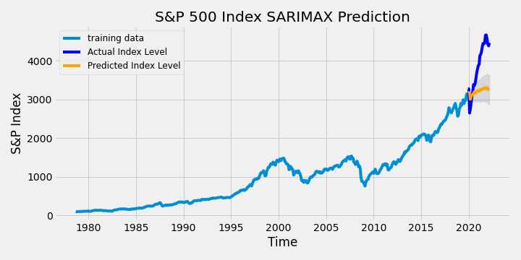
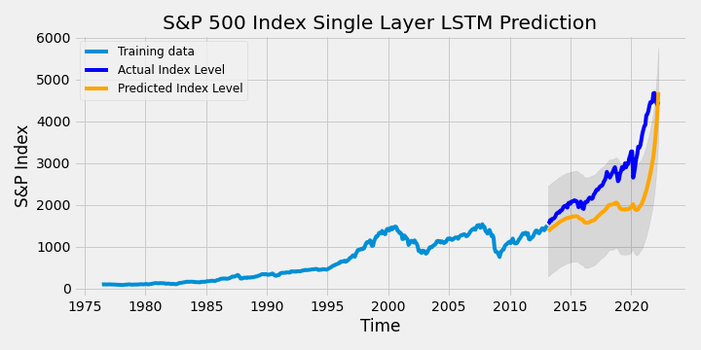
Analysis – Modeling & Model Selection
auto_arima – AIC
Deep learning model architecture
Cross-validation
Root Mean Square Error (RMSE) as the metric to measure model performance across different model classes

Slide 17
Analysis – Forecasting Result
Best Model: ARIMA (0, 1, 1)
Point estimate of the index level: 4484.35
95% confidence interval: [4384.23, 4584.47]
Annualized monthly return: 4.24%
Assuming the average inflation in 2022 is 7.5%, the annual return of the S&P 500 is 11.74% since equity is inflation hedged

Slide 18
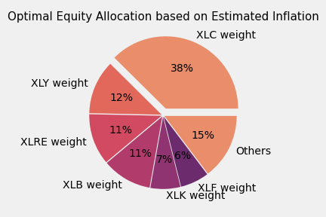
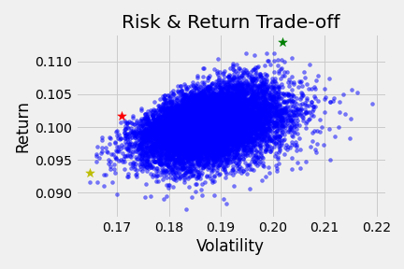
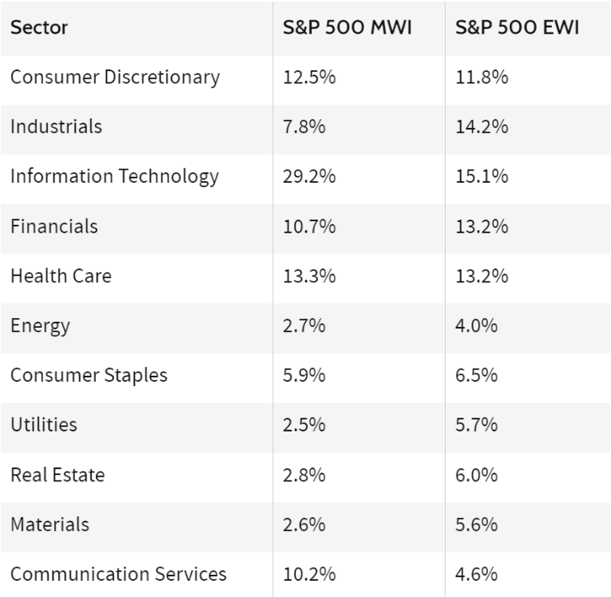
Analysis – Portfolio Construction
XLC is overweighted
XLY is about the same weight as the normal S&P index
XLRE, XLK, and XLF are underweighted
XLB is overweighted

Slide 19
Conclusion & Next Steps

Slide 20
Conclusion & Next Steps
Predicting the S&P 500 index and allocating portfolios based on the forecasted return
Univariate lagged return, the impact of the FED, forecasting model, and portfolio construction
Validate different trading strategies under certain market conditions
Back testing and simulation
Incorporate return patterns into the model & account for lags
Develop deep learning methods
Multivariate deep learning models & extract the market sentiment from news and social media
Forecasting inflation to have a better return target to build the optimal portfolio

